Slide 1
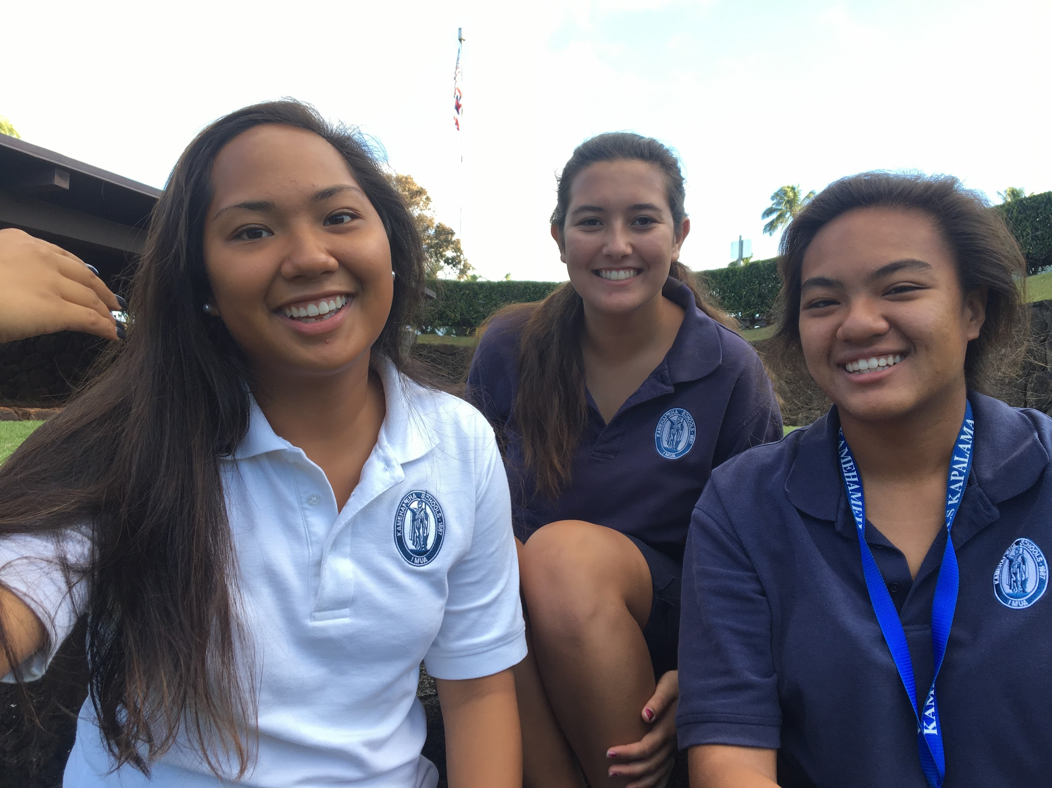
Save the 75
By: Cloe Paet, Hauherenui Peters,
& Kaylee-Brooke Manuel

Slide 2
Process:
Talk to Sustainable coastlines
Talked to Love your coast
Talked to Byu
Had to talk to them about their students
Beach with students
Went to separate beaches:
Nanakuli Beach Park
Waianae Beach Park
Hukilau Beach (Laie) with BYU Students
Clean up at Paki (Sustainable Coastlines)
Problems...

Slide 3
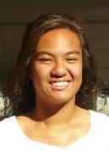
Kaylee’s Biography
My name is Kaylee-Brooke Manuel. I was born and raised in Nānākuli Oʻahu. I am currently a sophomore at Kamehameha Schools. Growing up, my cousins and I would spend our Sundays at the beach. From after church till about sunset. We all enjoyed going to the beach and swimming till the sun set. I wouldn’t want to see something of my childhood be filled by debris.

Slide 4
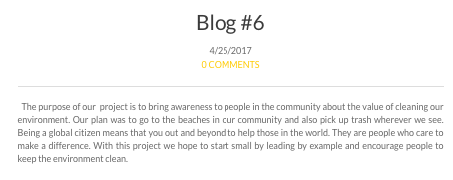
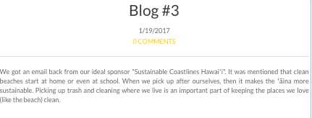
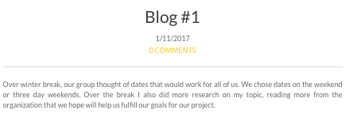
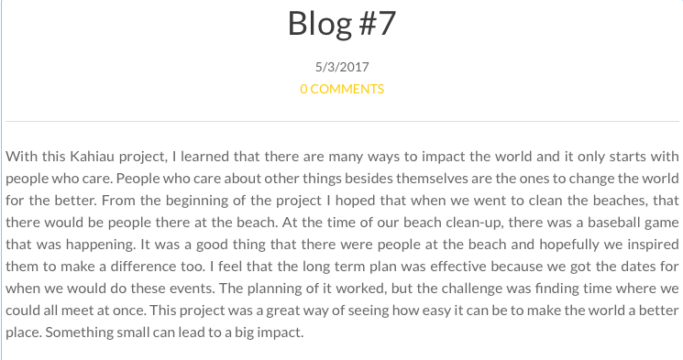
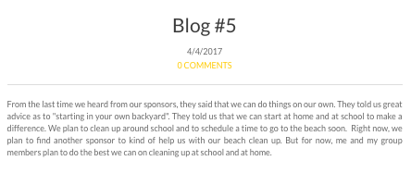

Slide 5
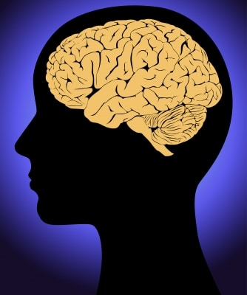
Kaylee’s Reflection
With this Kahiau project, I learned that there are many ways to impact the world and it only starts with people who care. People who care about other things besides themselves are the ones to change the world for the better. From the beginning of the project I hoped that when we went to clean the beaches, that there would be people there at the beach. At the time of our beach clean-up, there was a baseball game that was happening. It was a good thing that there were people at the beach and hopefully we inspired them to make a difference too. I feel that the long term plan was effective because we got the dates for when we would do these events. The planning of it worked, but the challenge was finding time where we could all meet at once. This project was a great way of seeing how easy it can be to make the world a better place. Something small can lead to a big impact.

Slide 6
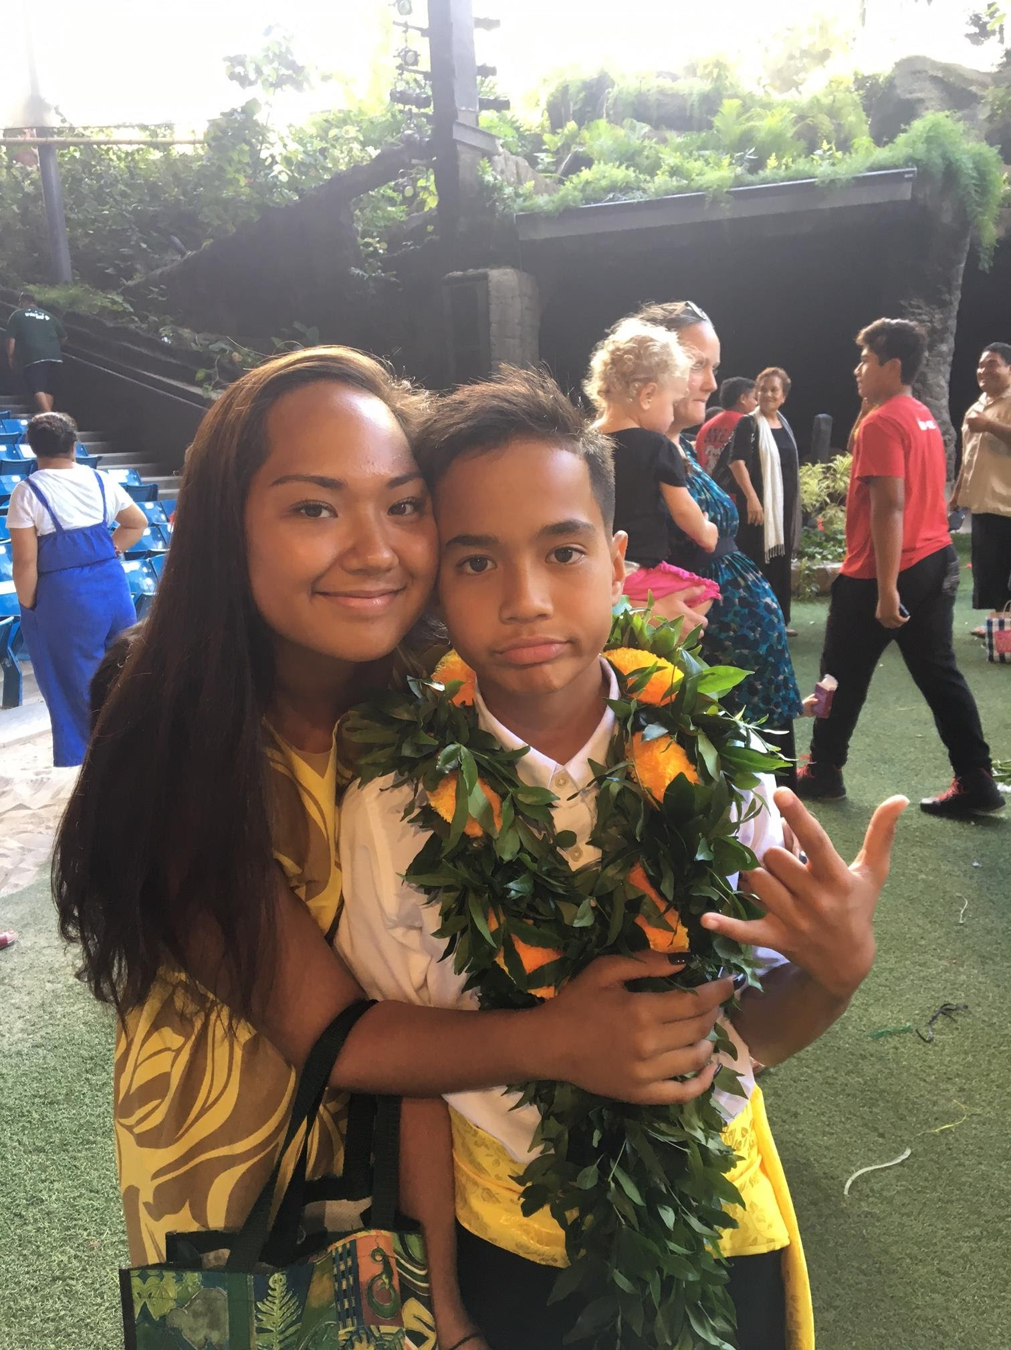
Hauherenui Peters ;)
My name is Hauherenui Peters, and I am 16 years old. For 11 years of my life, I lived in Utah and didn’t feel the need to take care of my environment. In the mainland, people don’t realize how much their pieces of trash can affect the environment as a whole. This project really applies to myself as a Hawaiian and a student, because I have a passion and love for the beach. Surfing is my favorite thing to do, so finding trash in the water is sickening. The land takes care of us, so we should take care of the land for ourselves and future generations.

Slide 7
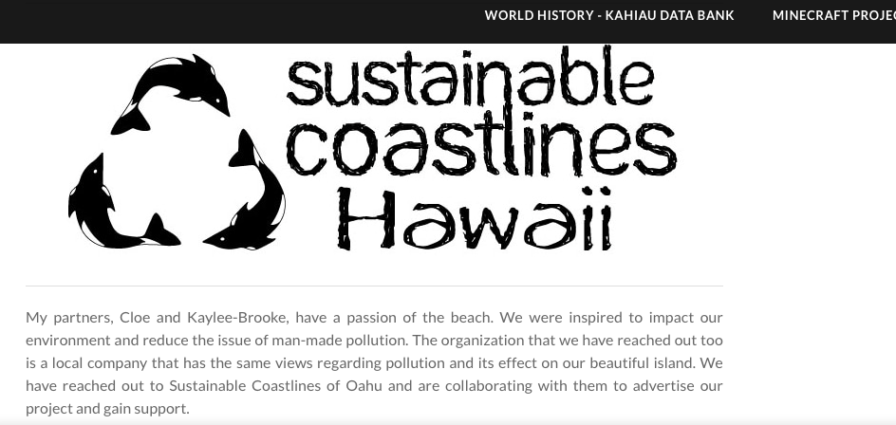
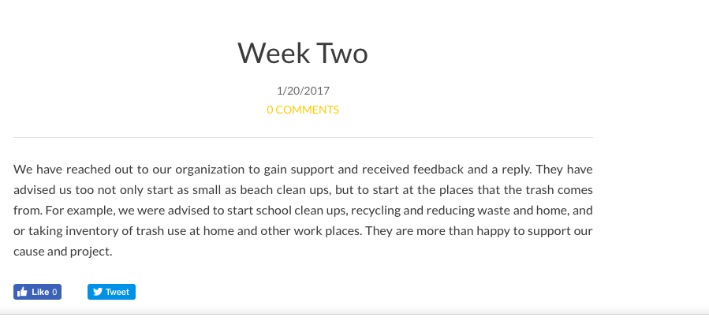
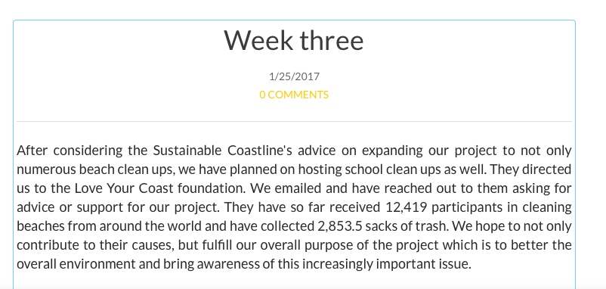
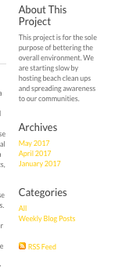
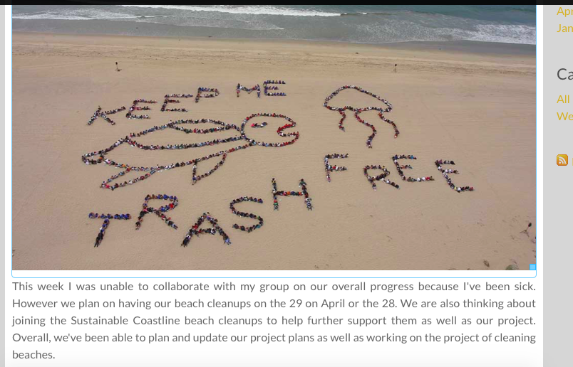
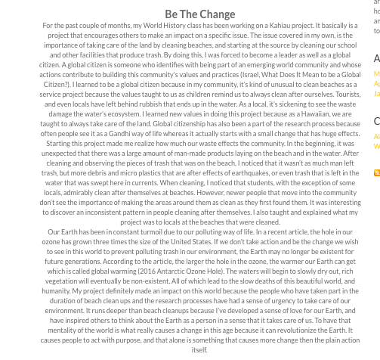
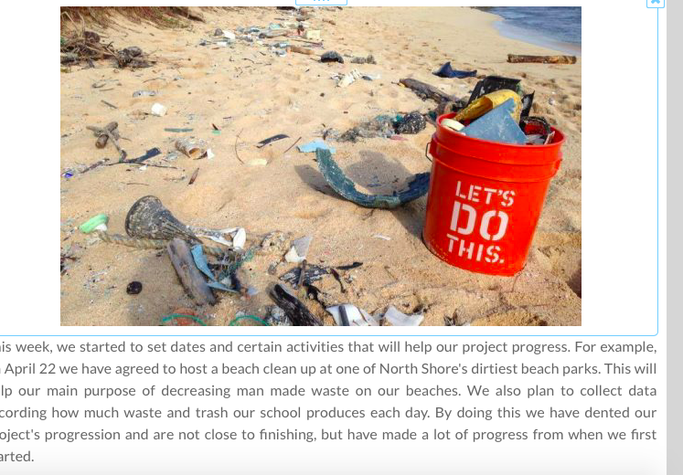

Slide 8
Hauhere’s Reflection
Starting this project made me realize how much our waste affects the community. In the beginning, it was unexpected that there was a large amount of man-made products laying on the beach and in the water. After cleaning and observing the pieces of trash that was on the beach, I noticed that it wasn’t as much man left trash, but more debris and microplastics that are after effects of earthquakes, or even trash that is left in the water that was swept here in currents. When cleaning, I noticed that students, with the exception of some locals, admirably clean after themselves at beaches. However, newer people that move into the community don’t see the importance of making the areas around them as clean as they first found them. It was interesting to discover an inconsistent pattern in people cleaning after themselves. (More can be found in my formal reflection.)

Slide 9
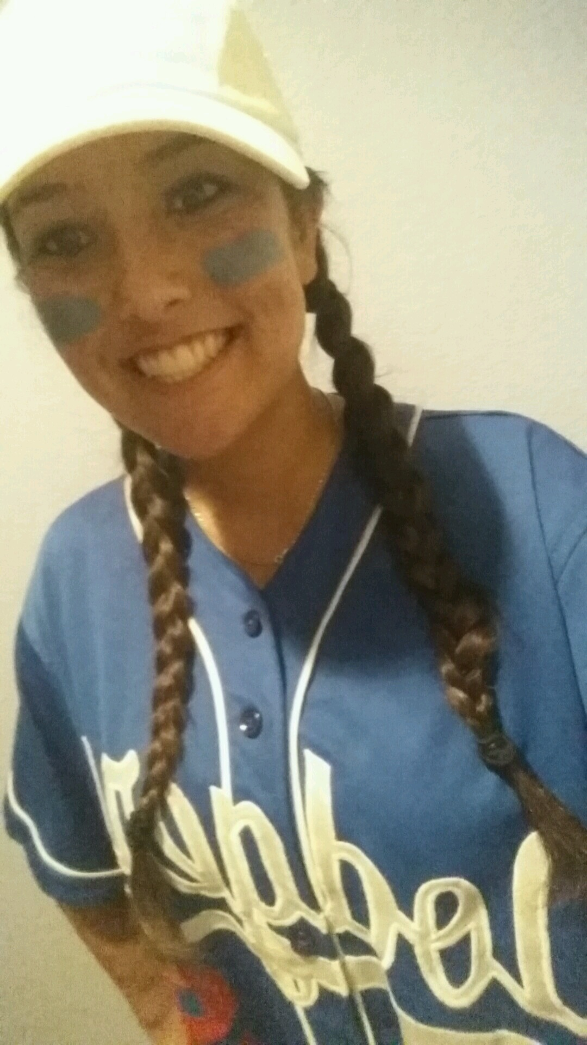
Cloe’s Biography
I am a student at Kamehameha Schools and I’m apart of the Band program. I am in the class of 2019. I was born and raised in Makakilo, Oahu. I love the environment and hope that the world doesn’t ruin the world more. Art is one of my favorite thing to do on my free time. I can see the beauty in our world, but I also see the rubbish and ugliness that we created. My goal is to create an impact on the world.
I believe that this project is important because I am able to help in my community in some way. I think that cleaning a beach is important because I am able to impact this world one step at a time. I know that this project was simple and it seems like we didn’t do much, but a lot of effort was put into this clean up and we struggled, but I am glad we were able to clean the beaches and make them look so much better.

Slide 10
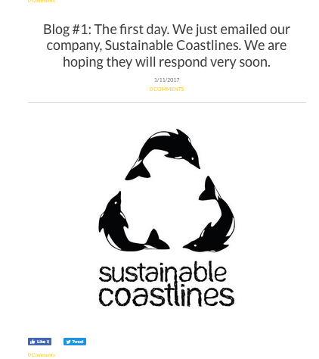
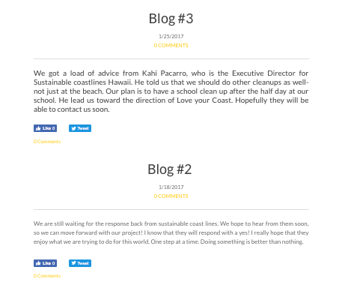
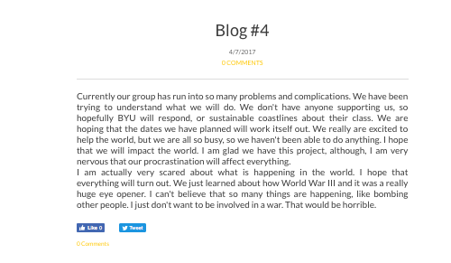
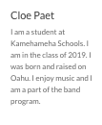
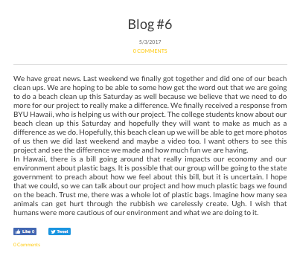
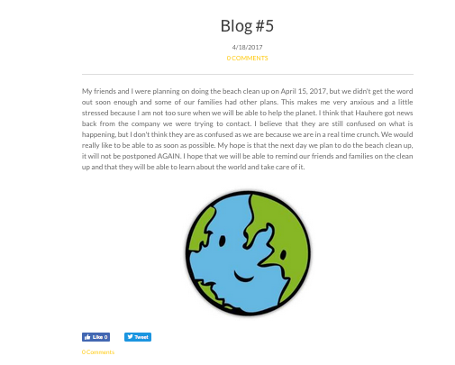
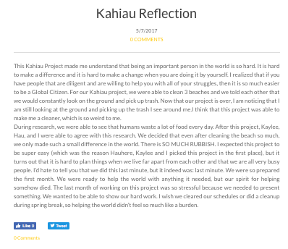

Slide 11
Cloe’s Reflection
This Kahiau Project made me understand that being an important person in the world is so hard. It is hard to make a difference and it is hard to make a change when you are doing it by yourself. I realized that if you have people that are diligent and are willing to help you with all of your struggles, then it is so much easier to be a Global Citizen. For our Kahiau project, we were able to clean 3 beaches and we told each other that we would constantly look on the ground and pick up trash. Now that our project is over, I am noticing that I am still looking at the ground and picking up the trash I see around me. I think that this project was able to make me a cleaner, which is so weird to me.
During research, we were able to see that humans waste a lot of food every day. After this project, Kaylee, Hau, and I were able to agree with this research. We decided that even after cleaning the beach so much, we only made such a small difference in the world. There is SO MUCH RUBBISH. I expected this project to be super easy (which was the reason Hauhere, Kaylee, and I picked this project in the first place), but it turns out that it is hard to plan things when we live far apart from each other and that we are all very busy people. I’d hate to tell you that we did this last minute, but it indeed was: last minute. We were so prepared the first month. We were ready to help the world with anything it needed, but our spirit for helping somehow died. The last month of working on this project was so stressful because we needed to present something. We wanted to be able to show our hard work. I wish we cleared our schedules or did a cleanup during spring break, so helping the world didn’t feel so much like a burden.

Slide 12
Our Mission
We are trying to motivate others to take care of our environment. We are trying to bring awareness to our communities that this world is our home and we should take care of it. We want people to take action now before it’s too late. We are trying to motivate people to pick up trash wherever you can. Picking up trash doesn’t need to be at the beach, but it can be anywhere.

Slide 13
BYU-Hawaii
Our non-profit organization we chose was the college of BYU Hawaii. When we started, we originally reached out to the Sustainable coastlines and Love your coast foundations. They both failed to support us because they didn’t see how they would be of fail. We then reached out to BYU Hawaii because college students also had a passion of cleaning and bettering our environment. College students also wanted to learn more about our purpose and project.

Slide 14
We Would Like To thank Byu Hawaii
We are so thankful to BYU Hawaii for supporting us because we were stressed out during this whole project and they were able to help us with beach cleanups and teaching the students about how to treat the environment.

Slide 15
Results?
At the end of our project, we ended up attending and hosting numerous beach clean ups. As a group, we didn’t recognize how much our actions of cleaning up could impact the overall community. Hauhere received a lot of comments on her ‘leadership’ and taking action of cleaning beaches. Cloe taught her church friends about our project and they now care about their community. Kaylee shared her experiences with her parents and now they have a passion similar to ours on beaches.

Slide 16
Imovie !

Slide 17
Work cited
Hille, Karl. "2016 Antarctic Ozone Hole Reaches Moderate Size." NASA. NASA, 25 Oct. 2016.
Web. 08 May 2017.
Israel, Ronald C. "What Does It Mean to Be a Global Citizen?" Kosmos Journal. Kosmos, 2012.
Web. 08 May 2017.

Slide 18
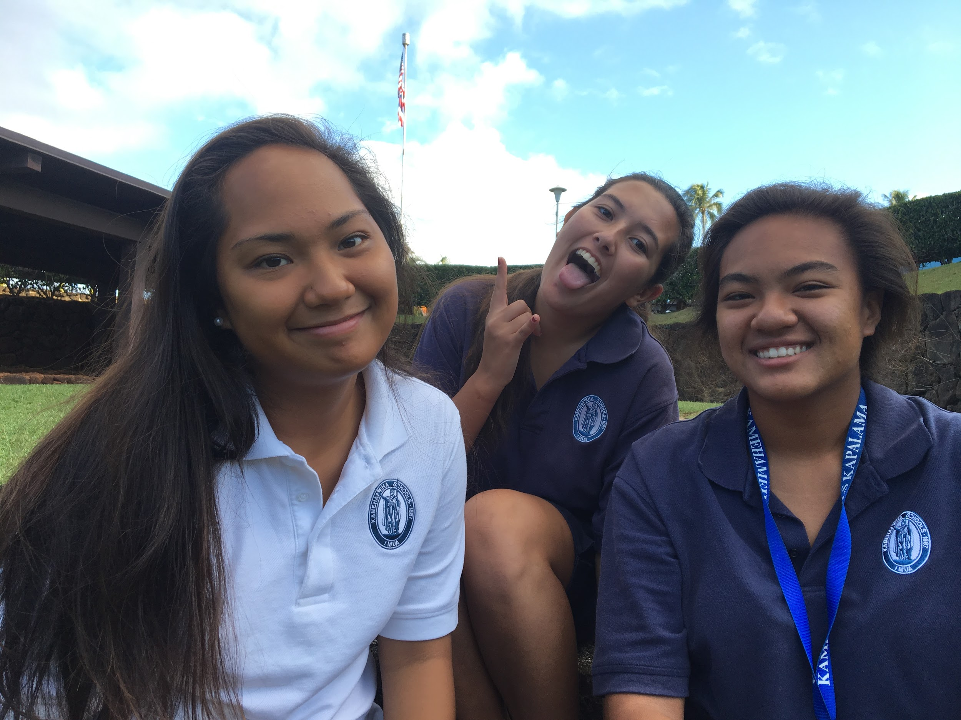
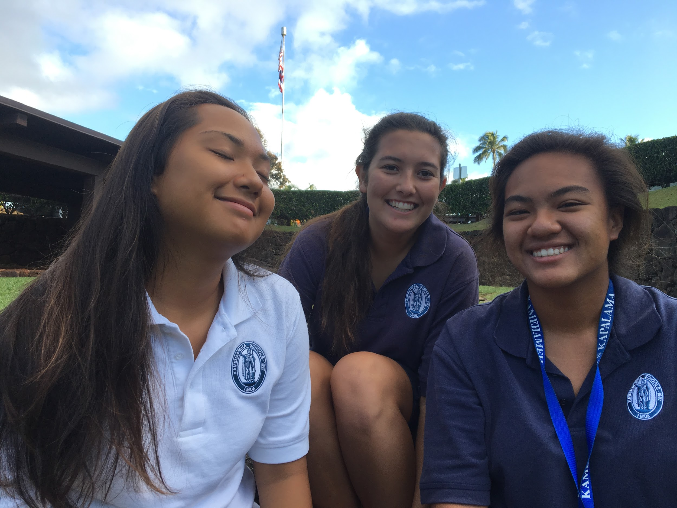
The End!
Mahalo!

