Slide 1
Pure Water Project
By: Mason, Jenakye, Kona, and Jakob

Slide 2
Easter Egg Hunt
Throughout our presentation there will be water bottles hidden. The classes job is find them and count the amount without shouting the answer. At the end we will ask the amount and if it is correct then everyone will get a prize.

Slide 3
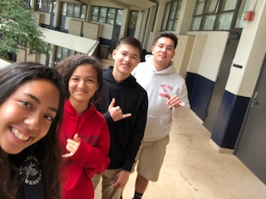
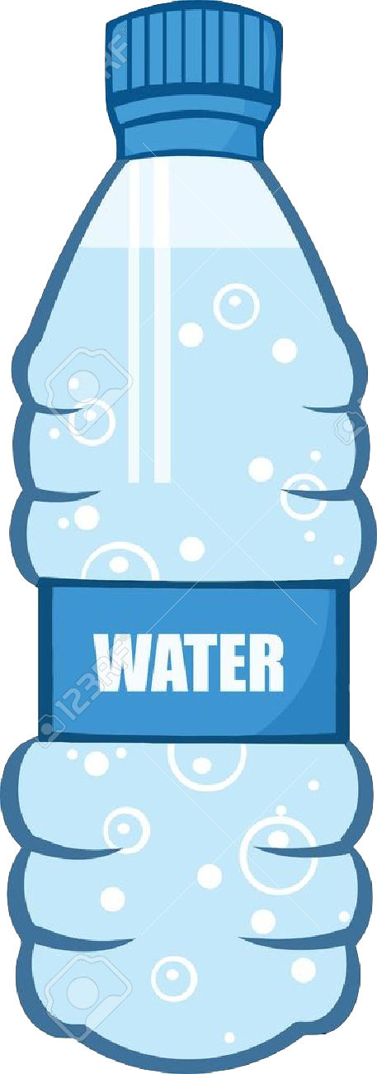
Group Picture
Left - Right: Kona, Jenakye, Mason, Jakob

Slide 4
Beat The Clock
The class must name 10 different beaches, each from a different person. If the class reaches 10 or more beaches then everybody will get a prize.

Slide 5
1.
UN Goal Connection To Our Project

Slide 6
UN Goal Connection
Goal #14: Life Below Water - The world’s oceans – their temperature, chemistry, currents and life – drive global systems that make the Earth habitable for humankind. How we manage this vital resource is essential for humanity as a whole, and to counterbalance the effects of climate change.
Our project connects to the UN Goal because it relates to the decrease in ocean pollution, and the decrease in pollution found on beaches.

Slide 7
Act It Out
The class must be split into 4 groups of 5 people, each group will be given a topic (out of two topics) and the group has 5 minutes to make a play about that topic that’s about 20 or more seconds.
Topics: Finding trash at the beach and telling a friend to pick up trash

Slide 8
How Pollution is Affecting Marine Life.

Slide 9
2.
Importance and Significance of Coral and Fish.

Slide 10
The Coral Reefs
Global warming has contributed to the bleaching of many coral reefs.
About one fifth of the world’s coral reefs have been lost or severely damaged
In another 10-35 years we could lose another 40%
Overfishing and destructive fishing habits are also to blame.

Slide 11
How This is Affecting the Fish
This affects the fish because they need a home/habitat to live in. Without that they won’t be able to survive .
Fish are a main source of food here in Hawaiʻi, and with all the death of coral the fish will find a new home other than here.

Slide 12
3.
Research

Slide 13
Ocean Pollution
Globally
The toxic waste, land runoff, sewage, ocean mining, etc. all play a big role of destroying our ocean in many ways
Some of the effects of ocean pollution include: affecting the food chain, destroying ecosystems, affecting human health, etc.
Locally
We have a big problem with pollution, since our islands produce so much activity in tourism and much more, that creates trash
Quick Fact: Our state is home to the most polluted beach in the world

Slide 14
Economic Impacts
With the war between two ideas of how to run a government, we’ve found that this idea has made people do very regrettable things to our oceans
For example, with a war that has passed there has been a revolution of materials being made, a surge in pollution. A pollution that eventually makes its way to the ocean.
A fight between two ideas made us produce materials like metal, armor, weapons, ammunition, bombs, etc.

Slide 15
Impacts of Modern Warfare
In the modern time and not in our past we still continue to do the same problems.
Just imagine our military, out of all the nations we were the number one nation to practice with bombs in our ocean.
This kind of nuclear testing made radiation problems, made islands uninhabitable, killed or deformed our ecosystem/wildlife and much more

Slide 16
Colonization
Definition: the action/process of settling among and establishing over the indigenous people of an area
Tourism causes the need for buildings
Big fast food chains come to Hawaiʻi
overrule local businesses, damaging our culture

Slide 17
United Nations
UN Goal #14: Life Below Water
“Careful management of this essential global resource is a key feature of a sustainable future.”
UN Goal #15: Life On Land
“Sustainably manage forests, combat desertification, halt and reverse land degradation, halt biodiversity loss”

Slide 18
Mālama Learning Center
Vision: to reconnect with the community through educating the West Oʻahu region about art, science, and conservation
Goal: Promote sustainable living throughout the island

Slide 19
Personal Reflections

Slide 20
Personal Reflection
Jakob - Leadership plays a big role in our lives, the people that guide us can either make a big impact in a good way or a bad way. In history, we can find good examples of leadership in Pauahi or Kamehameha. Lastly, in my opinion the only way to understand leadership is just listen, listen to the leaders in your life and you will understand what kind of person a leader is.

Slide 21
Personal Reflection
Mason - Giving back to the community isn’t a hard thing, some of us do it without knowing it. If each of us take a little time out of our day to throw away trash we see, we can make a big difference.

Slide 22
Personal Reflection
Kona - With the right kind of leadership a person can make a big impact in our problem of ocean pollution. This problem that we face of who will lead us for our problem has showed us that there will always be someone out there who can do the right thing.

Slide 23
Personal Reflection
Jenakye - Our group and the people that we teach about this problem can create a pattern of people passing down the knowledge of what we taught. How you guys will do that is unknown but our impact is something we hope affected someone's life.

Slide 24
Thanks!
Any questions?
Time for a Kahoot!

Slide 25
Credits
https://www.undp.org/content/undp/en/home/sustainable-development-goals/goal-14-life-below-water.html

